Slide 1
IDEA
To create the website for taking xerox for the student what they required,they can request to the xerox centre by signup with the basic details of the student .
To avoid the inconvenience the particular material want by the student can take only one copy ,this can be done by requesting the copy with their register number by doing this we can avoid the inconvenience to the xerox center .The material can be uploaded in .pdf format

Slide 2
TECHNOLOGY STACK
FRONT END - HTML and CSS
BACKEND – PHP

Slide 3
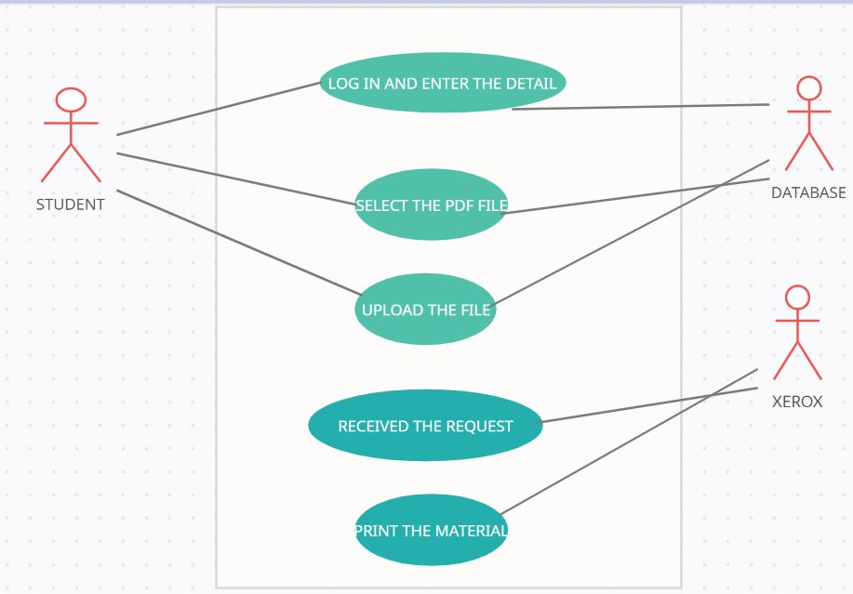
USE CASE : PDF DOCUMENT TO MATERIAL
When the student request the material to the xerox centre they can request with the help of the basic details and the number of the copies can be request with the register number ,ie(only one copy of the partiular material can be take) .

